Slide 1
Augmented Reality

Slide 2
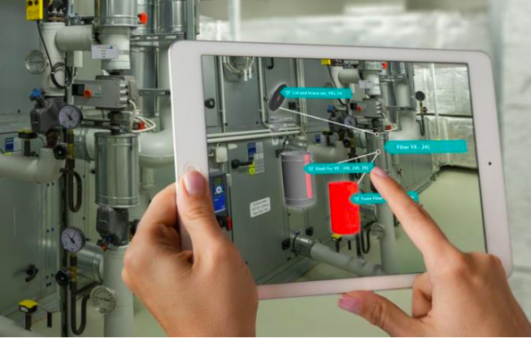
Object recognition and tracking
Use object recognition and tracking to create an augmented reality application.
Recognize an image in a scene, track its position, and augment the display by playing a video or the detailed information in the image’s place.

Slide 3
features
Allowing the fast and easy integration of digital and visual contents for instance into technical documentation.
Used in prototyping and construction to maintenance and operations.
We can also capture the image, share the images through social media.
It combines real and virtual environment and also Interactive in real time.
Tracking by object detection.

Slide 4
Vuforia is a standalone library that allows applications to recognize images, boxes, cylinders, text, and arbitrary objects in the environment.
Typically, Vuforia matches images caught from a camera with a pre-defined reference image.
If the majority of reference feature points are found on a camera frame, then the image is recognized as the marker.
Vuforia is also capable of recognizing 3D objects.

Slide 5
Requirements
Vuforia
Unity5
Web camera
Objects for tracking
3d models of objects
Marker

Slide 6
Thank you!!

